Slide 1
Stanford ME469: Common low-Mach Discretization Approaches: EBVC
Stefan P. Domino
Computational Thermal and Fluid Mechanics
Sandia National Laboratories SAND2018-4536 PE

Slide 2
Review of Discretization Options
Let’s revisit out curved, heart domain
DOFs at cell-centered: Stencil is based on a element:face:element; Tet4 elem ~6xNumNodes
DOFs at vertices of elements, or “nodes”, element:node (CVFEM, FEM), edge:node (EBVC)

Slide 3
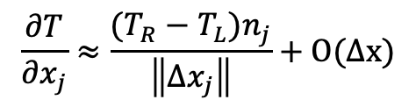
Equal Order Interpolation Edge-Based Vertex-Centered (EBVC) Finite Volume
All primitives are collocated at the vertices of the elements with equal-order interpolation
A dual mesh is constructed to obtain flux and volume quadrature locations
Classic two-state, “L” and “R” approach provides spatially second-order accuracy
Surface quadrature point (area summed to edge)
Volume quadrature point (sub-vol summed to node)
Same grad-op as CC:
Iterate nodes for volume contributions
Iterate edges for surface flux contribution
Dual nodal volume
$$\frac{∂T}{∂x_{j}}≈\frac{(T_{R}−T_{L})n_{j}}{\left\|{Δx}_{j}\right\|}+O(∆x)$$
Area vector
T_{L}
n_{j}
T_{R}
Dual-volume definition
Edge-based stencil

Slide 4
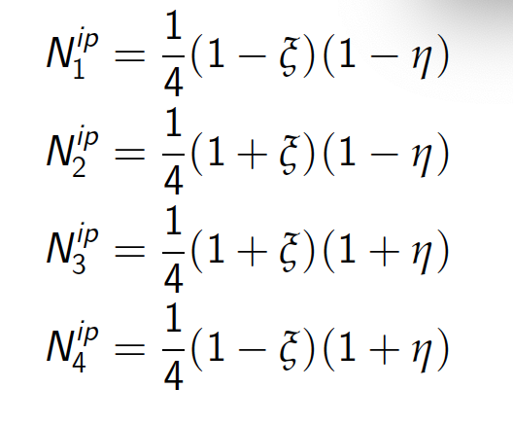

Example of a Quadratic Basis Function
1. 3. 2
3
Quadratic Linear
Two-dimensional promotion

Slide 5
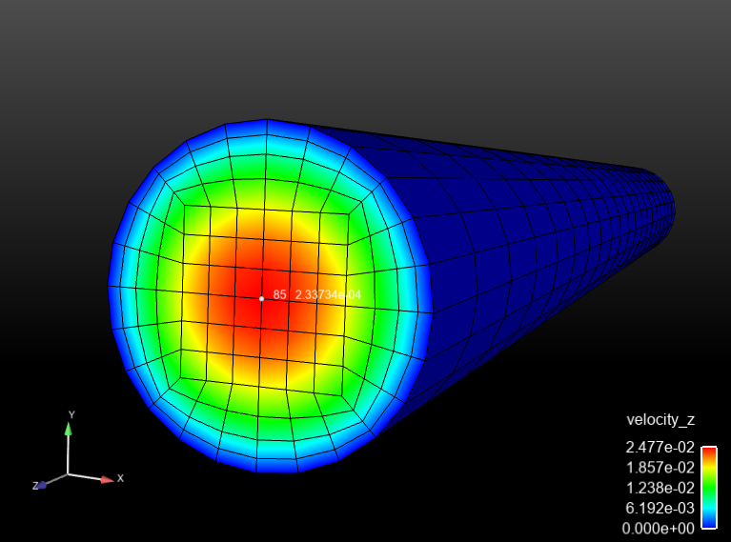
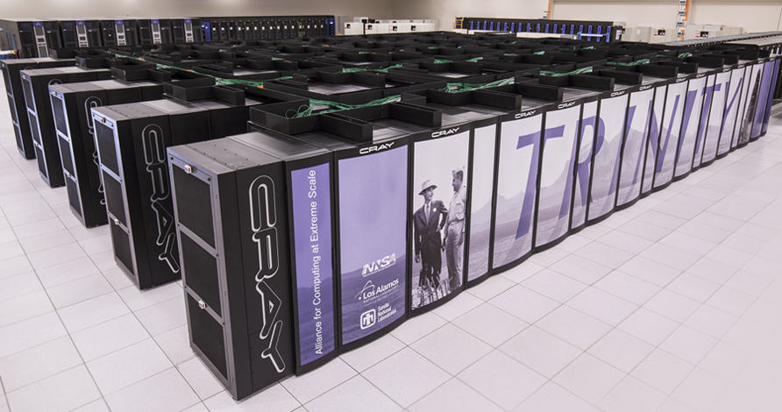
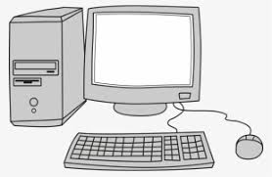

Running a CFD Simulation: Essential Attributes
Mesh
Input File(s)
- inflow_boundary_condition: bc_left
target_name: Inflow
inflow_user_data:
velocity: [1.0,0.0]
mixture_fraction: 0.0
Hex8
Tet4
launch remotely
launch locally
output.log
output.e.32.*
output.rst.32.*
Remote Viz
>scp output.e.32.* /to/my/local/disk

Slide 6
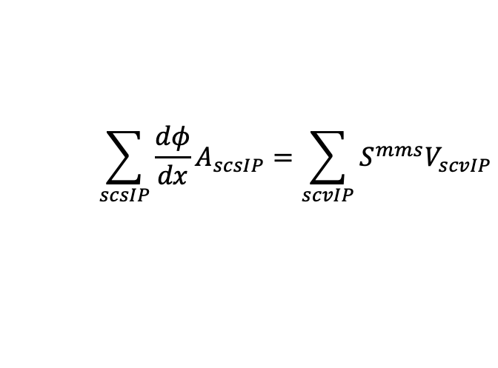
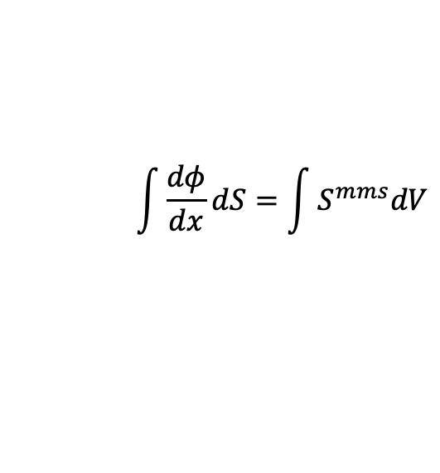
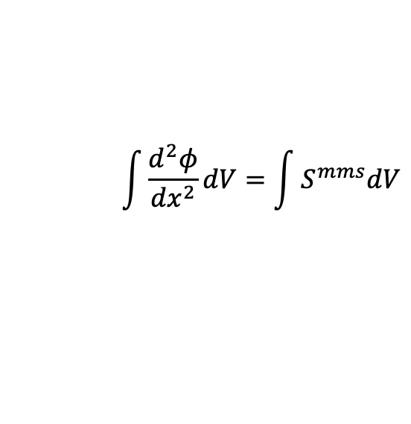
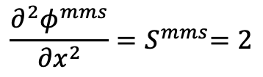
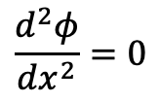
Simple One-D MMS Example; General Form
Consider a simple diffusion equation:
with a presumed, or manufactured solution:
$$\frac{d^{2}φ}{{dx}^{2}}=0$$
$$\frac{∂^{2}φ^{mms}}{{∂x}^{2}}{=S}^{mms}=2$$
Gauss-Divergence
$$\int{\frac{d^{2}φ}{{dx}^{2}}dV}=\int{S^{mms}dV}$$
$$\int{\frac{dφ}{dx}dS}=\int{S^{mms}dV}$$
Discrete flux-based form:
$$\sum_{scsIP}{\frac{dφ}{dx}A_{scsIP}=\sum_{scvIP}{S^{mms}V_{scvIP}}}$$
With error:

Slide 7
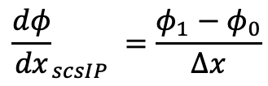
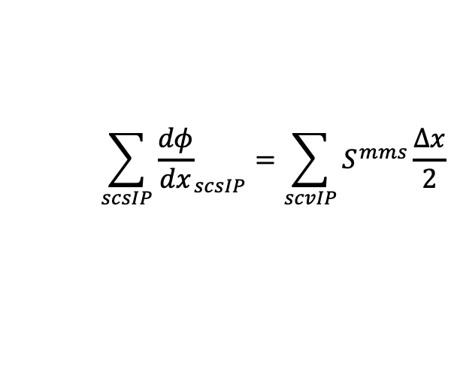
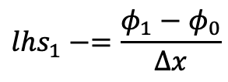
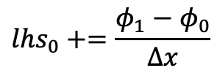
Simple One-D MMS Example; Edge-based Assemble of Diffusion
We will use a linear basis and solve this system over a small patch of linear bar elements
node = 0
1
Δx = 1
2
3
x
x
x
Recall, simplified equation with RHS from source term already provided
Iterate elements with a simple left-hand side rule: += L and -=R
(note implicit conservation statement)
$$\sum_{scsIP}{{\frac{dφ}{dx}}_{scsIP}=\sum_{scvIP}{S^{mms}\frac{∆x}{2}}}$$
0
1
x
$${lhs}_{0}+=\frac{φ_{1}−φ_{0}}{∆x}$$
Edge 1
$${\frac{dφ}{dx}}_{scsIP} =\frac{φ_{1}−φ_{0}}{∆x}$$
$${lhs}_{1}−=\frac{φ_{1}−φ_{0}}{∆x}$$

Slide 8
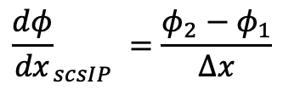
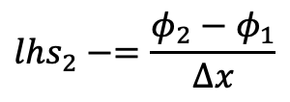
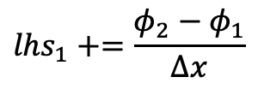
Simple One-D MMS Example; Edge-based Assemble of Diffusion
We will use a linear basis and solve this system over a small patch of linear bar elements
node = 0
1
Δx = 1
2
3
x
x
x
Recall, simplified equation with RHS from source term already provided
Iterate elements with a simple left-hand side rule: += L and -=R
(note implicit conservation statement)
$$\sum_{scsIP}{{\frac{dφ}{dx}}_{scsIP}=\sum_{scvIP}{S^{mms}\frac{∆x}{2}}}$$
1
2
x
$${lhs}_{1}+=\frac{φ_{2}−φ_{1}}{∆x}$$
Edge 2
$${\frac{dφ}{dx}}_{scsIP} =\frac{φ_{2}−φ_{1}}{∆x}$$
$${lhs}_{2}−=\frac{φ_{2}−φ_{1}}{∆x}$$

Slide 9
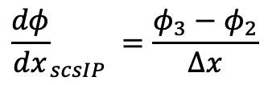
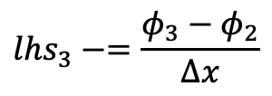
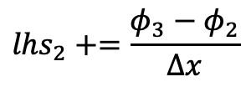
Simple One-D MMS Example; Edge-based Assemble of Diffusion
We will use a linear basis and solve this system over a small patch of linear bar elements
node = 0
1
Δx = 1
2
3
x
x
x
Recall, simplified equation with RHS from source term already provided
Iterate elements with a simple left-hand side rule: += L and -=R
(note implicit conservation statement)
$$\sum_{scsIP}{{\frac{dφ}{dx}}_{scsIP}=\sum_{scvIP}{S^{mms}\frac{∆x}{2}}}$$
2
3
x
$${lhs}_{2}+=\frac{φ_{3}−φ_{2}}{∆x}$$
Edge 3
$${\frac{dφ}{dx}}_{scsIP} =\frac{φ_{3}−φ_{2}}{∆x}$$
$${lhs}_{3}−=\frac{φ_{3}−φ_{2}}{∆x}$$

Slide 10
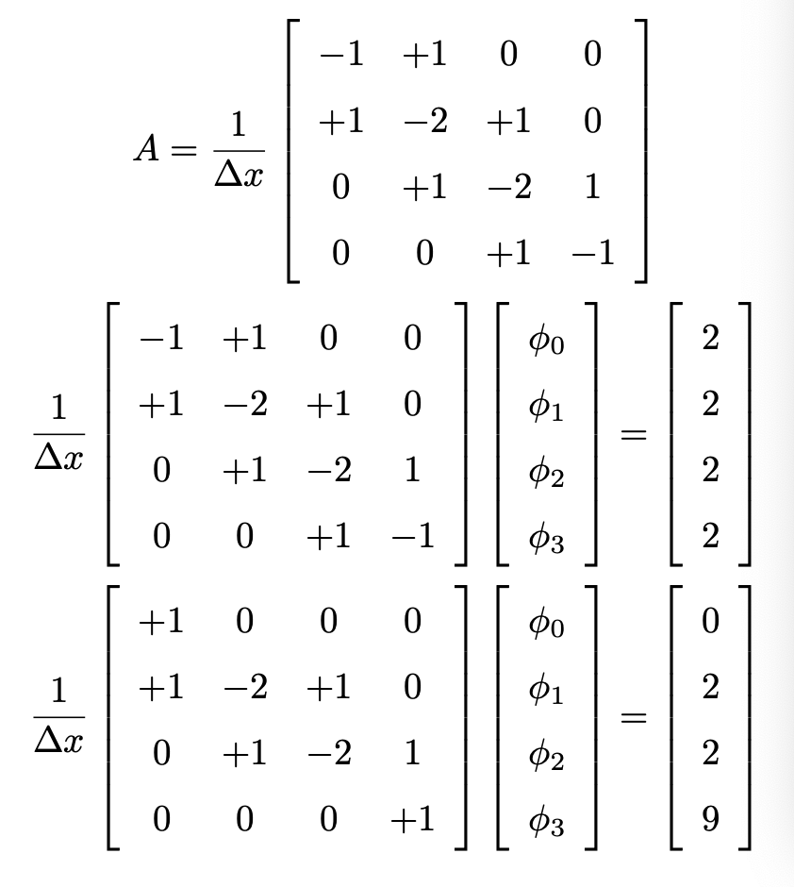
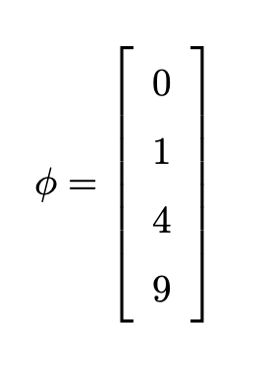
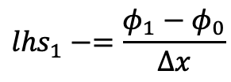
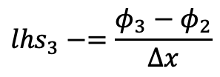
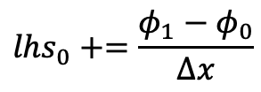
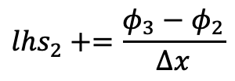
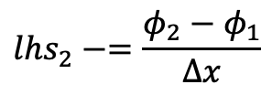
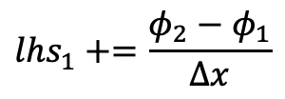
Simple One-D MMS Example; Collect all of the lhs entries
Fully assembled
matrix
$${lhs}_{0}+=\frac{φ_{1}−φ_{0}}{∆x}$$
$${lhs}_{1}−=\frac{φ_{1}−φ_{0}}{∆x}$$
Fully assembled
system
$${lhs}_{1}+=\frac{φ_{2}−φ_{1}}{∆x}$$
$${lhs}_{2}−=\frac{φ_{2}−φ_{1}}{∆x}$$
Correct for BCs
Correct for BCs:
$${lhs}_{2}+=\frac{φ_{3}−φ_{2}}{∆x}$$
$${lhs}_{3}−=\frac{φ_{3}−φ_{2}}{∆x}$$
Solution is exact….. Linear basis exactly captures a quadratic solution

Slide 11
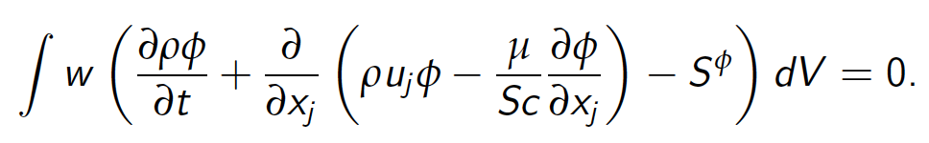
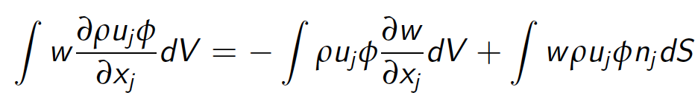
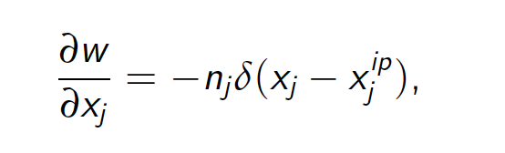
Model Passive Scalar Transport; Heaviside Test Function
Time/Src/Advection/Diffusion equation for scalar φ
Recall, the CVFEM and EBVC test function meets our requirement in that it is differentiable once
This definition also allows us to view such methods as Petrov-Galerkin schemes

Slide 12
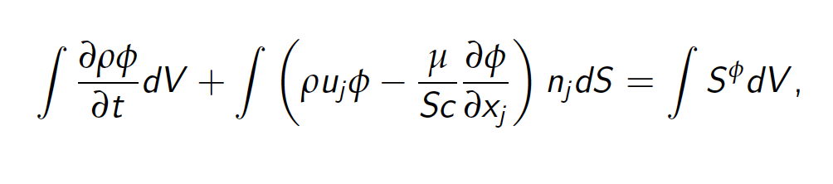
Model Passive Scalar Transport: Fully Implicit
Time/Src/Advection/Diffusion equation for scalar φ

Slide 13
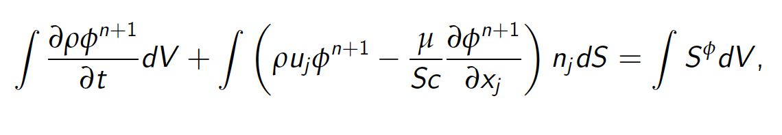
Model Passive Scalar Transport: Fully Implicit
Time/Src/Advection/Diffusion equation for scalar φ

Slide 14
Model Passive Scalar Transport: Coupling
Our fully coupled implicit system consists of: continuity, momentum, and mixture fraction
{
do while (!converged) {
}
For a given
time step:
Left-hand-side (LHS) or Jacobian is simplified for the passive scalar system
AΔx = b – Ax*=-res

Slide 15
Model Passive Scalar Transport: Coupling
Our fully coupled implicit system consists of: continuity, momentum, and mixture fraction; shown below in “residual form”
{
do while (!converged) {
}
X
X
X
X
For a given
time step:
X
X
X
X
X
X
X
X
X
X
X
X
X
X
X
X
X
Left-hand-side (LHS) or Jacobian is simplified for the passive scalar system
AΔx = b – Ax*=-res ~ MΔx

Slide 16
Deep Dive on EBVC
Recall, EBVC is a discretization scheme that:
Iterates over locally-owned nodes for Time/Source/etc. (volumetric-based terms)
Iterates over locally-owned edges for Advection/Diffusion/etc. (integrated by parts terms)
Below is the patch of elements connected to node 2 (a global matrix row number)
Area vector at the edge and dual volume at the node require the node:element connectivity whose quantities are determined in a pre-processing step
8
5
6
n5
e3
n1
n2
n3
1
2
3
e1
e2
e4
n4
7
4
Sample patch of elements
Note: No expectation of nodal ordering..

Slide 17
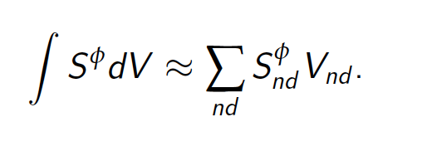
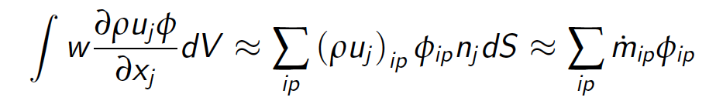
Deep Dive on EBVC: Node and Edge-loops
Recall, EBVC is a discretization scheme that:
Iterates over locally-owned nodes for Time/Source/etc. (volumetric-based terms)
Iterates over locally-owned edges for Advection/Diffusion/etc. (integrated by parts terms)
n5
n2
e3
n1
n2
n3
e1
e2
n1 (L)
n2 (R)
n2 (L)
n3 (R)
e4
e1
e2
n4

Slide 18
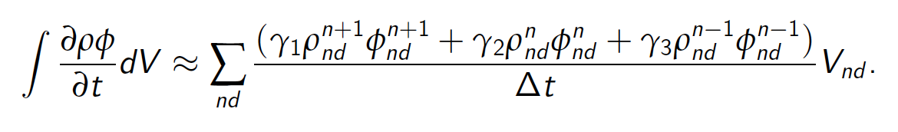
Deep Dive on EBVC: Implicit Time Discretization
Let us define a general implicit time integrator that is A-stable
For y’ = k y ; y(0) = 1; y(t) = e^{kt} solution approaches zero as time increases for k < 0
Backward Euler (two state) and is first-order accurate (A-stable)
BDF2 (three state) is second-order accurate (A-stable)
This term is assembled over a nodal iteration
For uniform time steps:
γ₁ = 3/2
γ₂ = -2
γ₃ = 1/2
n2

Slide 19
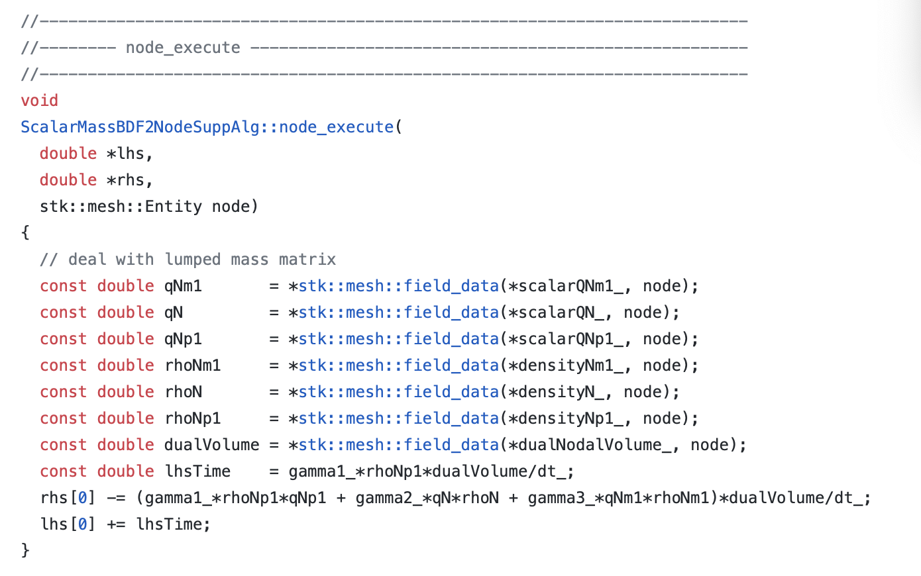
Deep Dive on EBVC: Implicit Time Discretization (Code)
https://github.com/NaluCFD/Nalu/blob/master/src/ScalarMassBDF2NodeSuppAlg.C
Note the implicit term

Slide 20
Deep Dive on EBVC: Source Term Discretization
Source terms for the edge-based scheme are also assembled over a nodal loop
Note that in this scheme, we are using single point quadrature, i.e., the function is evaluated at a single point
p = 2N -1
Where N is the number of integration points and p is the polynomial order
For a linear basis, using one-point quadrature is design-order
n2

Slide 21
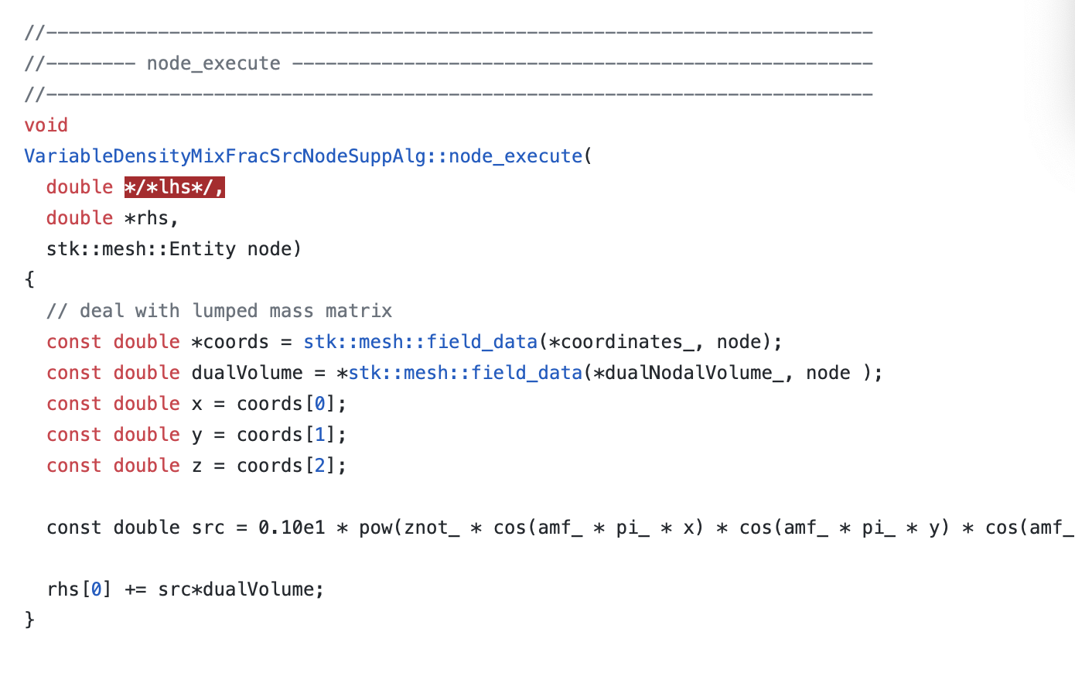
Deep Dive on EBVC: Source Term Discretization (Code)
https://github.com/NaluCFD/Nalu/blob/master/src/user_functions/VariableDensityMixFracSrcNodeSuppAlg.C

Slide 22
Deep Dive on EBVC: Advection Discretization (no stabilization)
For advection, we have transformed the volume integral to a surface integration
Therefore, a patch of edges are required for the full assembly at node 2
Recall, that the mass flow rate at an integration point is prescribed
Moreover, since the integration point is at the edge mid-point, φ_{ip} = (φ^{R} + φ^{L})/2
This is a central- or Galerkin-based advection operator; shown in conservative form
n5
n1 (L)
n2 (R)
n2 (L)
n3 (R)
e3
e1
e2
n1
n2
n3
Note: Advection term must be in divergence form….
e1
e2
e4
n4

Slide 23
Deep Dive on EBVC: Advection Discretization (Code)
https://github.com/NaluCFD/Nalu/blob/master/src/AssembleScalarEdgeSolverAlgorithm.C
This routine includes advection and diffusion

Slide 24
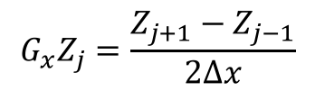
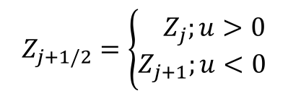
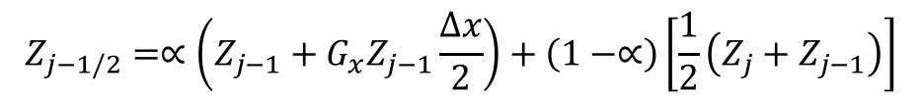
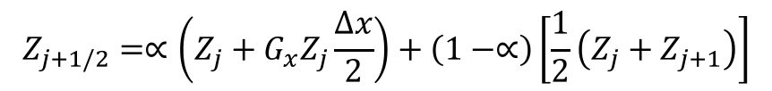
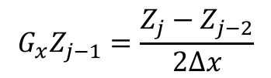
Upwind Operators; Scalar Z
Upwind advection operators can provide diagonal dominance (at the cost of accuracy)
However, upwind operators, even if higher-order, are numerically diffuse
Higher-order upwind (second-order in space) can be obtained on an unstructured mesh by use of projected nodal gradients and extrapolation:
j-1
Z_{j-1/2}
j
Z_{j+1/2}
j+1
$$Z_{j+1/2}=\left\{\begin{aligned}{ Z}_{j};u>0 \\ Z_{j+1};u<0\end{aligned}\right.$$
“as the wind blows”
$$G_{x}Z_{j}=\frac{Z_{j+1}−Z_{j−1}}{2∆x}$$
$$G_{x}Z_{j−1}=\frac{Z_{j}−Z_{j−2}}{2∆x}$$
$$Z_{j+1/2}=∝\left(Z_{j}+G_{x}Z_{j}\frac{∆x}{2}\right)+\left(1−∝\right)\left[\frac{1}{2}\left(Z_{j}+Z_{j+1}\right)\right]$$
α is a blending
parameter
for u>0
$$Z_{j−1/2}=∝\left(Z_{j−1}+G_{x}Z_{j−1}\frac{∆x}{2}\right)+\left(1−∝\right)\left[\frac{1}{2}\left(Z_{j}+Z_{j−1}\right)\right]$$

Slide 25
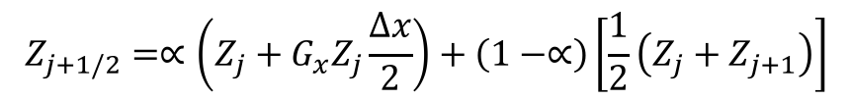
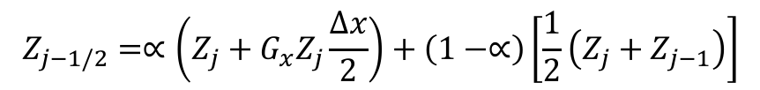
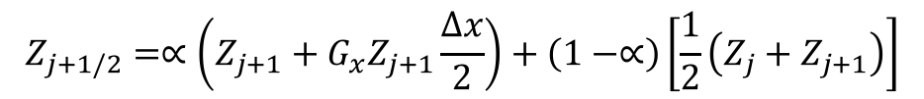
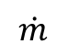
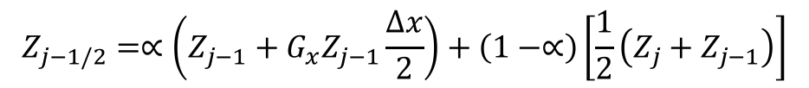
Pseudo Higher-order Upwind
Blending extrapolated upwind with central (Z_{L}+Z_{R})/2 provides:
Slope limiting required when gradients are not smooth (Berger et al, 2005, 43rd AIAA)
$$Z_{j+1/2}=∝\left(Z_{j}+G_{x}Z_{j}\frac{∆x}{2}\right)+\left(1−∝\right)\left[\frac{1}{2}\left(Z_{j}+Z_{j+1}\right)\right]$$
for u>0
$$Z_{j−1/2}=∝\left(Z_{j−1}+G_{x}Z_{j−1}\frac{∆x}{2}\right)+\left(1−∝\right)\left[\frac{1}{2}\left(Z_{j}+Z_{j−1}\right)\right]$$
$$Z_{j+1/2}=∝\left(Z_{j+1}+G_{x}Z_{j+1}\frac{∆x}{2}\right)+\left(1−∝\right)\left[\frac{1}{2}\left(Z_{j}+Z_{j+1}\right)\right]$$
for u<0
$$Z_{j−1/2}=∝\left(Z_{j}+G_{x}Z_{j}\frac{∆x}{2}\right)+\left(1−∝\right)\left[\frac{1}{2}\left(Z_{j}+Z_{j−1}\right)\right]$$
$$\dot{m}$$
j-2 | j-1 | j | j+1 | j+2 | α
1/4 | -5/4 | +3/4 | +1/4 | 0 | 1 | >0
0 | -1/4 | -3/4 | +5/4 | -1/4 | 1 | >0
+1/6 | -6/6 | +3/6 | +2/6 | 0 | 1/2 | <0
0 | -2/6 | -3/6 | +6/6 | -1/6 | 1/2 | <0
Resulting
1-D Stencil

Slide 26
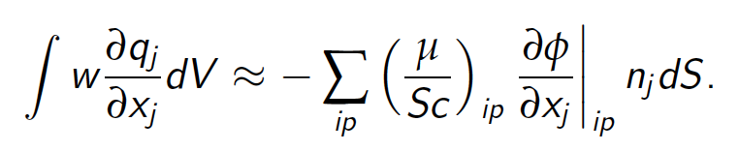
Deep Dive on EBVC: Diffusion Discretization
For diffusion, we have transformed the volume integral to a surface integration
Therefore, a patch of edges are required for the full assembly at node 2
n5
n1 (L)
n2 (R)
n2 (L)
n3 (R)
e3
e1
e2
n1
n2
n3
e1
e2
e4
n4

Slide 27
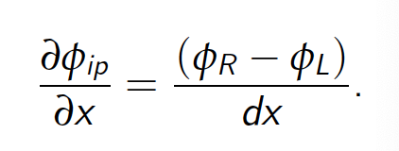

Deep Dive on EBVC: Diffusion Discretization
The edge-based diffusion operator is a bit more complex in that we are computing a gradient at the integration point while using two nodes, the left and right
In many practical meshes, the distance vector between the edges (dx_{j}) and the edge area vector will not be perfectly orthogonal
This non-orthogonality causes inaccuracy when using a simplified approach
The non-orthogonality approach of Jasek (Ph.D. Imperial College) is a standard cell-centered approach that has been adopted for edge-based schemes
CC and EBVC are each two-state schemes and share non-orthogonality issues
n2 (L)
n3 (R)
e2

Slide 28

Deep Dive on EBVC: Diffusion Discretization (code)
https://github.com/NaluCFD/Nalu/blob/master/src/AssembleScalarEdgeDiffSolverAlgorithm.C

Slide 29

Deep Dive on Nodal Gradient Operator: An Alternative View
Recall, that the edge-based diffusion operator, and for some choices for the advection operator, a nodal gradient is required
What is a nodal gradient? As formerly described in the Computing Gradients lecture, in a cell-centered context we obtained this via a number of ways, e.g., Green-Gauss, Least Squares, etc.
Let’s take another view…
First, the gradient of a function (other than linear) is discontinuous, i.e., the value at a shared element face depends on which element is used to compute the gradient
Therefore, we can view the nodal gradient a continuous at the nodes and discontinuous within the elements
Let’s minimize this difference:
by solving:
Lumped-mass

Slide 30
Types of Boundary Conditions
Inflow: values are known and enforced via a Dirichelp
Open: pressure known: flow in or out of the domain; zero gradient for diffusion
Wall: values are known and enforced via a Dirichlet
Symmetry: Normal stress specified; tangential stress zero
Non-conformal: hybrid DG/CVFEM
“overset”: Constraint-based
See: https://nalu.readthedocs.io/en/latest/source/theory/boundaryConditions.html

Slide 31
Deep Dive on EBVC: Example Case
For a mid-term set of example cases, we have selected a flow past a two-dimensional cylinder at a Reynolds number of 150
Mesh and input files can be found in the Nalu/examples/street directory
Familiarize yourself with this physics set via literature surveys
As a starting place, see: https://en.wikipedia.org/wiki/Kármán_vortex_street
Also look at the Canvas Nalu lecture notes for a brief write-up
In this test case, we have added a passive scalar field whose inflow is zero and wall boundary condition unity. For your final project, feel free to modify inflow and wall parameters as you choose.
Note that this case uses a conformal hybrid mesh, or a mesh of disparate element topologies, Quad4 and Tri3

Slide 32

Deep Dive on EBVC: Example Viz (Passive Scalar)
Hybrid mesh (quad4/tri3)

Slide 33
Some Interesting Configurations: Flow Parameters
- inflow_boundary_condition: bc_left
target_name: Inflow
inflow_user_data:
velocity: [1.0,0.0]
mixture_fraction: 0.0
Controls the flow Reynolds number (along with density and viscosity)
- symmetry_boundary_condition: bc_top_bottom
target_name: Sides
symmetry_user_data:
“slip”, or zero tangential velocity at top and bottom; change to a wall for a duct entrance example
- wall_boundary_condition: bc_cylinder
target_name: Cylinder
wall_user_data:
velocity: [0.0,0.0]
mixture_fraction: 1.0
Fixed velocity; change to rotating via user function?
﻿Time_Integrators:
- StandardTimeIntegrator:
name: ti_1
start_time: 0
termination_step_count: 2000
time_step: 1.0e-3
time_stepping_type: adaptive
time_step_count: 0
second_order_accuracy: yes
second_order_accuracy: yes/no

Slide 34

Some Interesting Configurations
Upwind using projected nodal gradients is limited
- limiter:
velocity: yes
mixture_fraction: no
- laminar_schmidt:
mixture_fraction: 0.9
- peclet_function_form:
velocity: tanh
mixture_fraction: tanh
- peclet_function_tanh_transition:
velocity: 2.0
mixture_fraction: 1000.0
- peclet_function_tanh_width:
velocity: 4.0
mixture_fraction: 100.0

Slide 35
Common low-Mach Discretization Approaches: Conclusions
Two-state methods, e.g., cell-centered and EBVC are attractive due to simplicity, however, suffer from non-orthogonality issues in the diffusion operator
Generally, CC or EBVC is 2x faster on a given mesh size
Less accurate/stable on generalized unstructured mesh topologies
Better diffusion operator on high-aspect ratio meshes

